Slide 1
SECURE DATA HIDING IN IMAGES USING STEGANOGRAPHY
CAPSTONE PROJECT
Presented By:
Student Name : DIVVELA HEMA HARSHINI
College Name & Department : NRI INSTITUTE OF TECHNOLOGY CSE(AI&ML)

Slide 2
OUTLINE
Problem Statement
Technology used
Wow factor
End users
Result
Conclusion
Git-hub Link
Future scope

Slide 3
Problem Statement
Ensuring secure communication without detection is a growing challenge in the digital world. Traditional encryption methods are often noticeable and prone to interception. There is a need for a discreet way to hide sensitive messages within digital media. This project addresses the problem by exploring a method to embed messages into images while maintaining their visual integrity.

Slide 4
Technology used
Programming Language: Python
Development Environment: Python IDLE
Library: OpenCV (cv2) for image processing
Platform: Windows
Concepts Used: Steganography, ASCII encoding, Pixel Manipulation

Slide 5
Wow factors
Unique Features :
Image-Based Steganography – Uses pixel manipulation to hide messages within images, making it discreet and less detectable compared to traditional encryption.
Passcode-Protected Decryption – Ensures only authorized users can retrieve the hidden message, adding an extra layer of security.
Minimal Visual Distortion – The image remains visually unchanged, preventing suspicion while securely storing data.
Lightweight and Simple – Uses Python and OpenCV, making it easy to implement without complex cryptographic algorithms.
Cross-Platform Compatibility – Can run on Windows, Linux, and macOS using Python IDLE, requiring minimal setup.

Slide 6
End users
Journalists & Whistleblowers – To securely share sensitive information without detection.
Cybersecurity Enthusiasts – For learning and experimenting with steganography techniques.
Intelligence & Law Enforcement Agencies – To covertly transmit confidential data.
Researchers & Academicians – For studying data-hiding techniques in digital media.
Individuals Concerned About Privacy – To protect personal information from unauthorized access.
Military and Defense Personnel – For secure and covert communication in critical operations.
Corporate Organizations – To protect confidential business communications from cyber threats.
Forensic Experts – To analyze and recover hidden data in digital investigations.
Digital Artists & Content Creators – For embedding hidden signatures or watermarks in their work.
Hackers & Ethical Hackers – For exploring and testing steganographic security vulnerabilities.
Software Developers – To integrate secure message-hiding techniques into their applications.
Data Protection Officers – To implement secure data-sharing methods in compliance with privacy regulations.

Slide 7

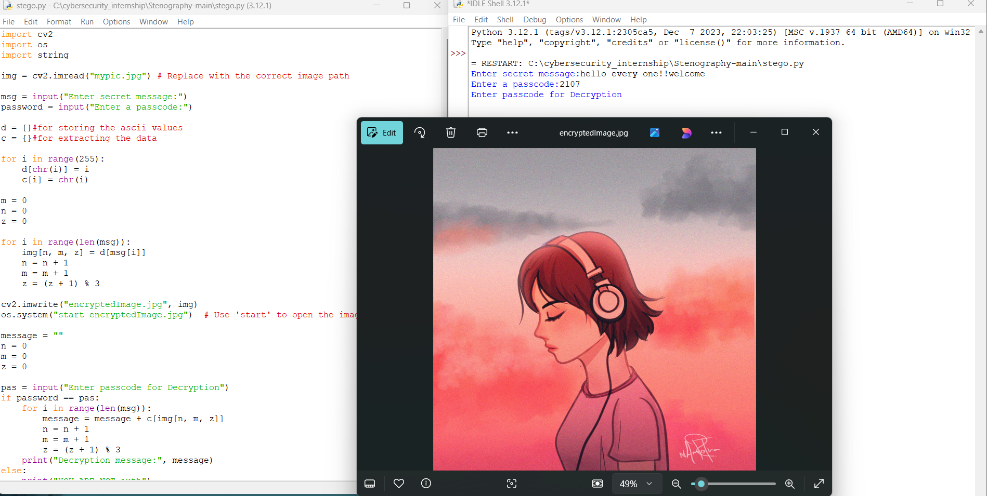
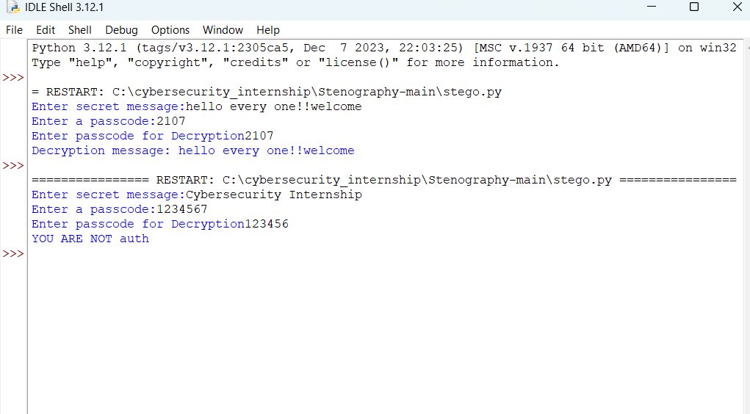
Results
Encrypted image will be same as original image
Image is holding the data
Only authorized users can access data

Slide 8
Conclusion
This project successfully addresses the challenge of secure and discreet communication by embedding secret messages within images using pixel manipulation. Unlike traditional encryption methods, which can be easily detected, this approach leverages steganography to conceal data while preserving the image’s visual integrity. The passcode-based decryption ensures that only authorized users can access the hidden message, enhancing security. This lightweight yet effective solution can be applied in various fields, including cybersecurity, digital forensics, and confidential communication.

Slide 9
GitHub Link
Make sure that there should be readme file

Slide 10
Future scope(optional)
Enhanced Security Mechanisms – Implementing advanced encryption before embedding messages to strengthen protection against unauthorized access.
Support for Different File Formats – Extending the technique to support audio, video, and other multimedia files for broader application.
Machine Learning Integration – Using AI to optimize and automate the detection and extraction of hidden messages.
Increased Storage Capacity – Developing techniques to embed larger amounts of data without compromising image quality.
Real-Time Steganography – Enabling live communication with hidden messages in video streams for secure transmissions.
Blockchain for Verification – Utilizing blockchain technology to track and verify hidden data for authentication and tamper-proof security.
Mobile & Web Applications – Creating user-friendly apps that allow easy encryption and decryption on smartphones and web platforms.
Anti-Forensic Techniques – Implementing methods to resist detection by forensic tools that analyze steganographic content.

Slide 11
THANK YOU

